Slide 1
Address Book
A Console Based Contact Manager in C++
A project by:
Zain Ul Hassan
Ezza Ansar
Uswa Ahmad Khan
Faiza Amin

Slide 2
Concept
Address Book is a simple yet powerful console based application that allows users to manage their contact efficiently. The main purpose of this project is to create a user friendly interface that allows users to add, edit or delete contacts. The application is built using the C++ programming language.

Slide 3
Features
Add new contact
Edit existing contact
List all contacts
Delete a contact
View contact details

Slide 4
Tools and technology
C++ Programming Language
Code Blocks IDE

Slide 5
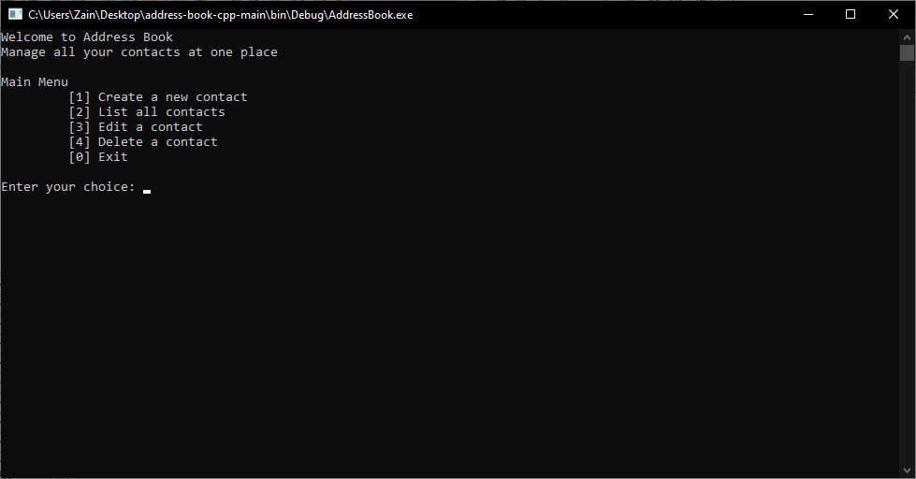

Slide 6
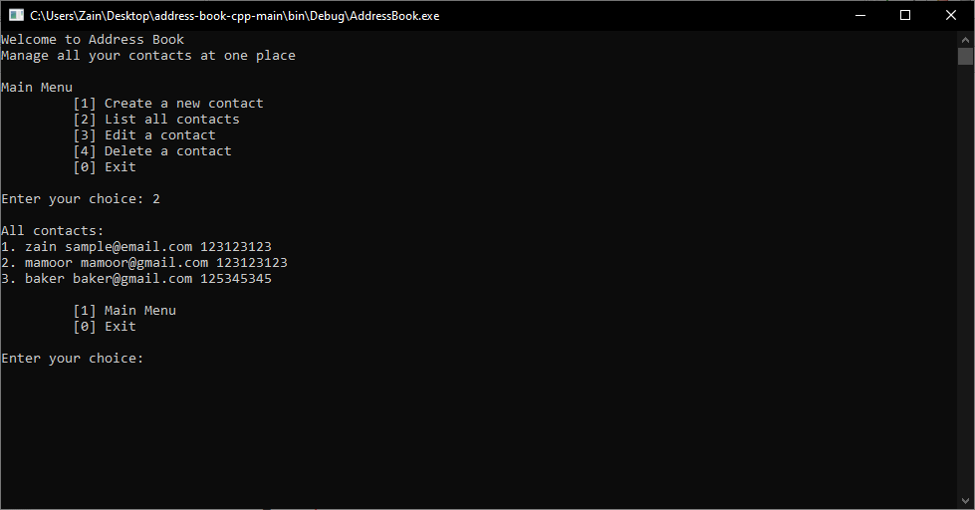

Slide 7
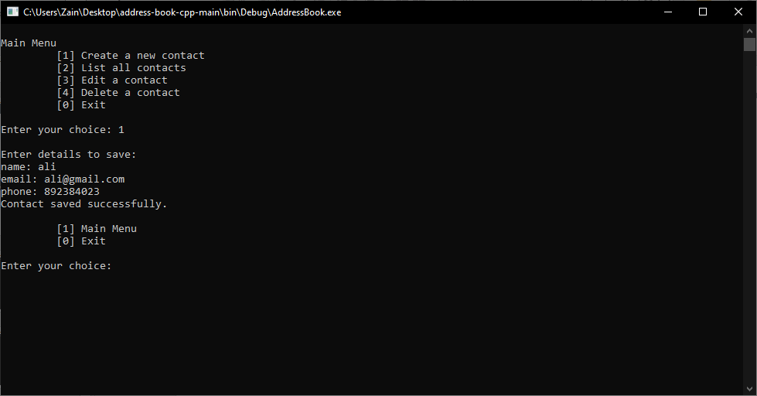

Slide 8
Project outcomes
Basic concepts such as variables, functions, loops, arrays etc.
Advance concepts like structures and file handling
Improving problem solving skills
Practicing software development practices
Enhancing collaboration skills

